Slide 1
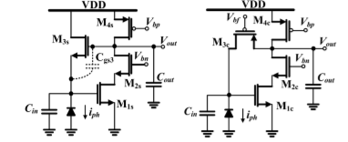
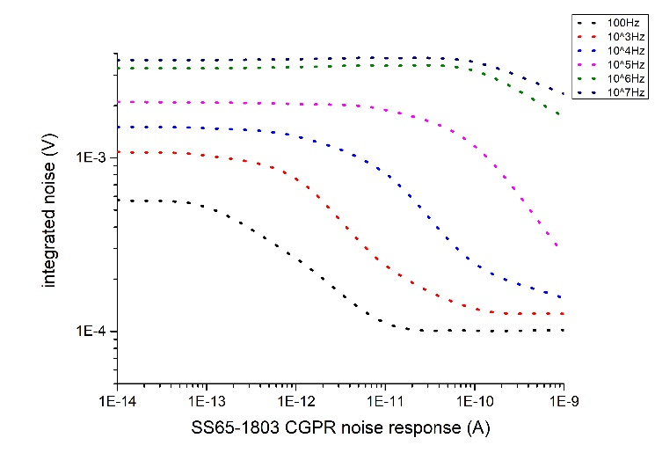
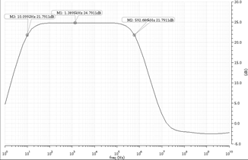
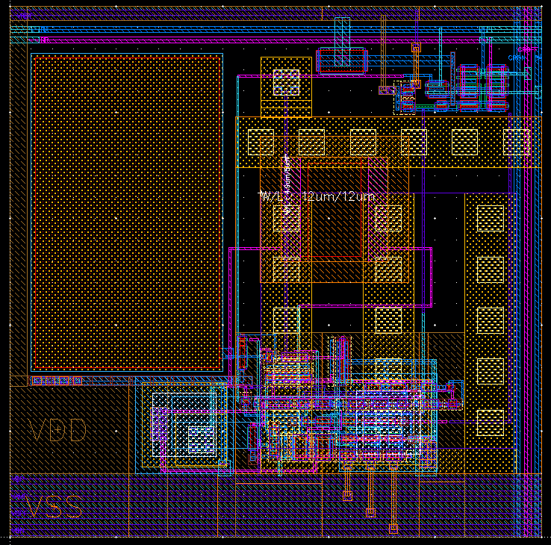
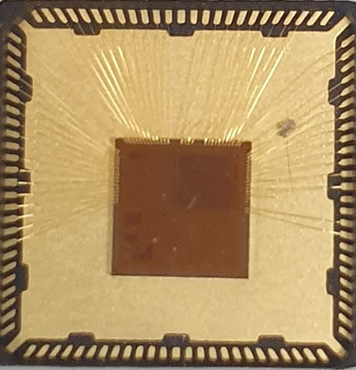
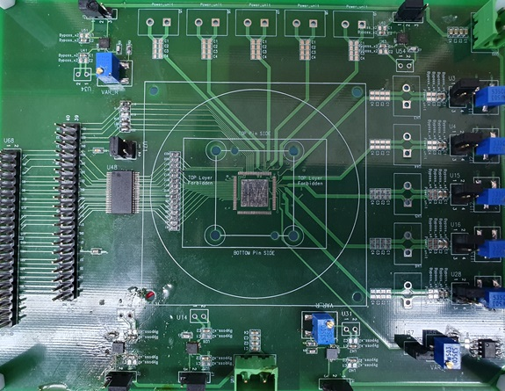
Design of DVS with CGPR structure in Standard CMOS 65nm Process
Jung-Gyun Kim and Byung-Geun Lee
Gwangju Institute of Science and Technology, junggyunkim@gist.ac.kr
INTRODUCTION
Fig.1. Schematic diagrams of two different photoreceptor circuits
Table 1. Transistor parameters of the CGPR structure
Fig. 2. SS65 Spectre-simulated output noise of CGPR with different pixel bandwidths
Dynamic vision sensor (DVS) is a neuromorphic event-driven sensor which transforms temporal contrast (TC) of light intensity of a pixel into spike event. Event type and x-y address data of the pixel are transmitted through asynchronous address event representation (AER) digital circuits. As DVS operates in the event-driven manner, the representation of the data is inherently sparse and no data redundancy exists. These properties are a great advantage in real time simulation compared to conventional image sensors. Important performance specifications of DVS are pixel noise and TC sensitivity. Higher TC sensitivity leads to finer expression of texture. We tried to improve TC sensitivity using high density metal-insulator-metal(MIM) capacitor in SS65 process while limiting the noise level with common-gate photoreceptor (CGPR) structure.
Transistor name | Transistor size W/L[um/um]
P1 (feedback loop) | 0.3/0.1
P2 (Amp) | 0.21/1.0
N1 (Input) | 0.21/1.0
N2 (Cascode) | 0.21/0.1
CGPR photoreceptor design for DVS
A. DVS pixel operation principle
DVS pixel consists of photoreceptor, differencing circuit and comparators. The photoreceptor circuit has the desirable properties that it automatically controls individual pixel gain (by its logarithmic response) while at the same time responding quickly to changes in illumination. Differencing circuit amplifies photoreceptor output and balancing its output to the reset level after the generation of an event. The gain of the amplification is determined by the well-matched capacitor ratio C1/C2. The effect of inevitable comparator mismatch is reduced by the precise gain of the differencing circuit.
B. CGPR photoreceptor structure design
Fig. 1 shows two types of photoreceptors used in DVSs. First one on the left is named as source-follower photoreceptor (SFPR). nFET on the feedback loop of the amplifier forms a source follower with the photodiode. The other one on the right is named as common-gate photoreceptor (CGPR) because of the common-gate pFET feedback loop. It is widely known that pFETs tend to have a lower 1/f noise compared to nFETs. As low noise level is essential for high TC sensitivity circuit design, CGPR is more likely to be chosen for the high performance DVS implementation. We also chose CGPR structure and size of the transistors is shown in Table I.
Theoretically, a normalized DC gain of CGPR is $U_{T}$, thermal voltage. It means that if 1% of photocurrent changes, output of the trans-impedance amplifier changes about 259uV and the noise level should be lower than that for 1% TC sensitivity. Cadence Spectre noise simulation for the CGPR structure based on Table I are processed and plotted in Fig. 2. The simulation was done for photocurrent $I_{ph}$ from $10fA$ to $1nA$ with different integration bandwidths from 100Hz to 10MHz.
Measurement and Result
Fig.3. (a) Spectre simulation of AC gain response of differencing circuit (b) 25um x 25um DVS Pixel layout in 65nm process
Fig. 4. (a) Chip photograph with QFN-100 package (b) Test-bench PCB for chip test
Fig. 5. Chip test output in a roomlight with no objects
2020 IDEC Congress CDC

